Slide 1

Design, build and test of a Digital Altimeter based on a Barometer
Group 3 (Salaheldin Mohamed Salah Hussein Hassan, Alexander Heppe, Mohamed Aziz Rais)

Slide 2
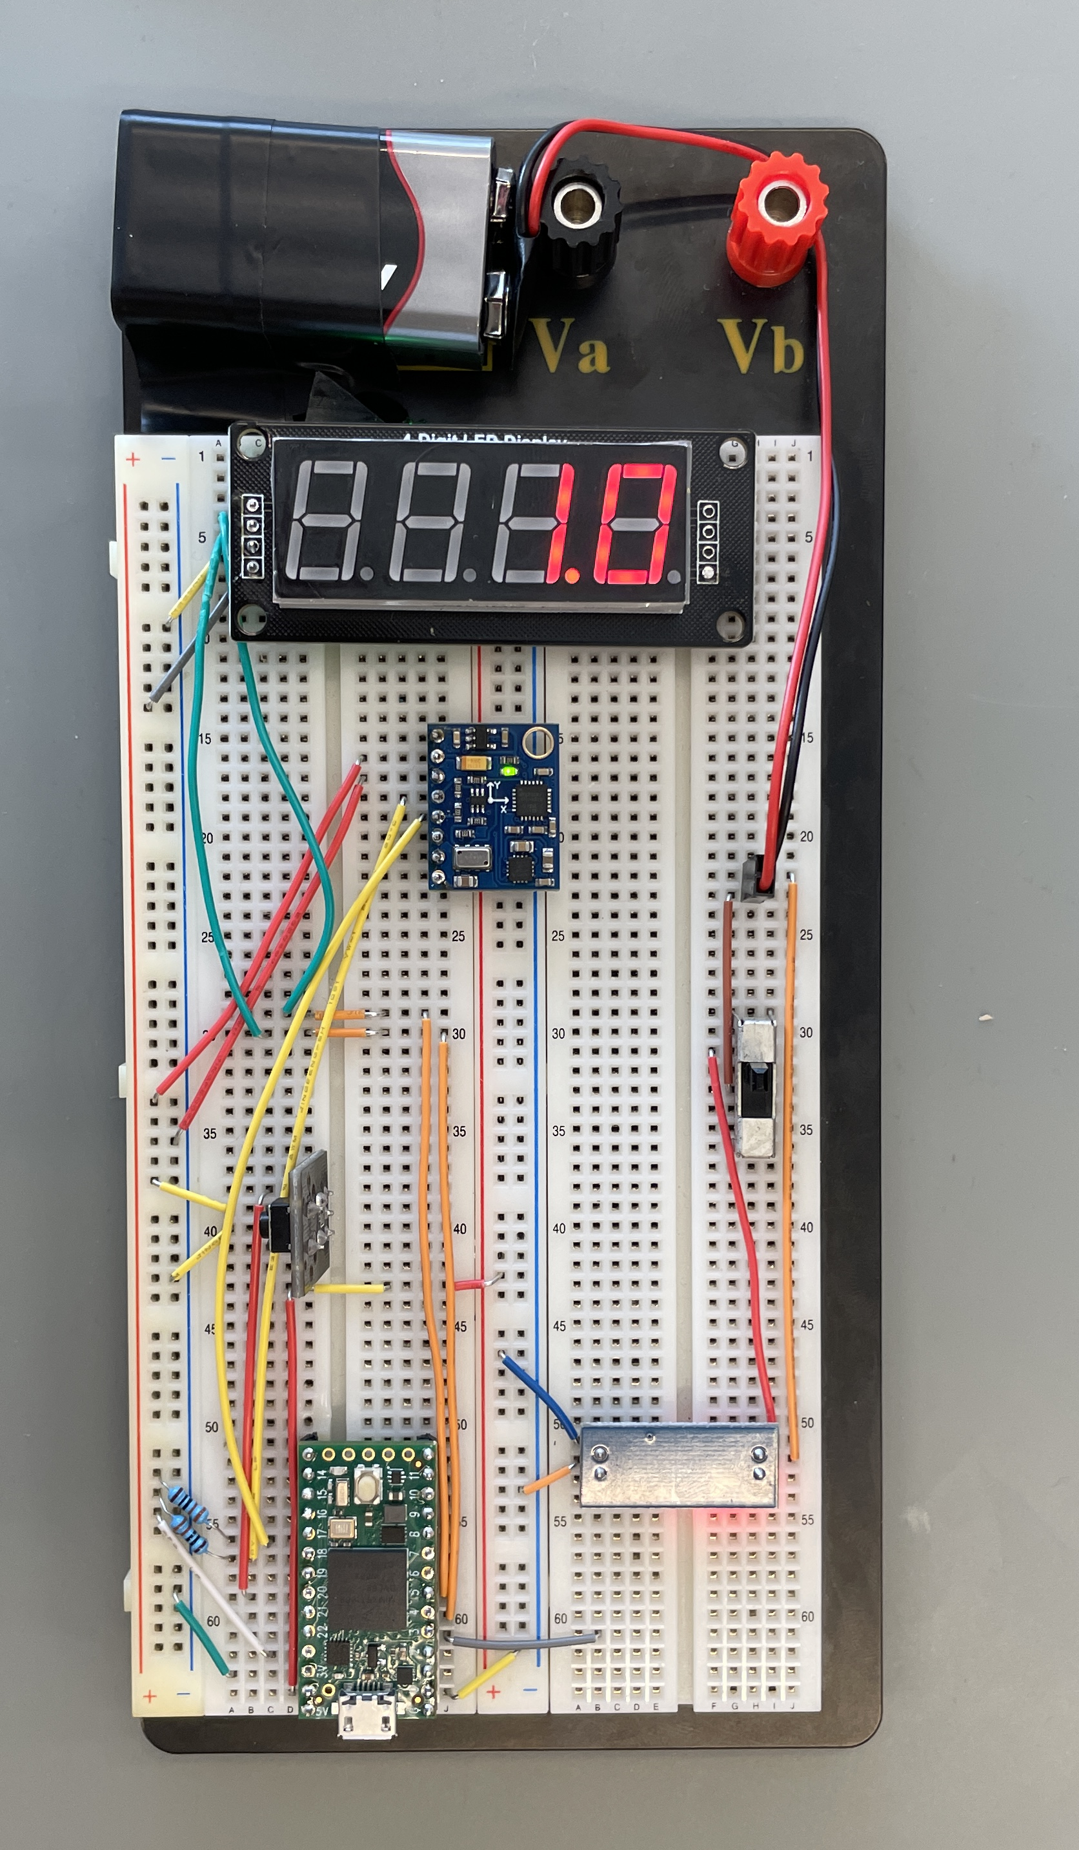
AGenda
Task description
Project Organization
Gantt chart
Bill of materials
Functional block diagram
Schematics
Printed circuit board design
Code
Tests
Manual

Slide 3
Problem description
Task:
Design, build, and test an altimeter based on a barometer
Tips:
The barometer you can use: MS5611
Display the current altitude on a 7-segment indicator
Test the performance of the altimeter with a laser distance measurer

Slide 4
Project Organization

Slide 5
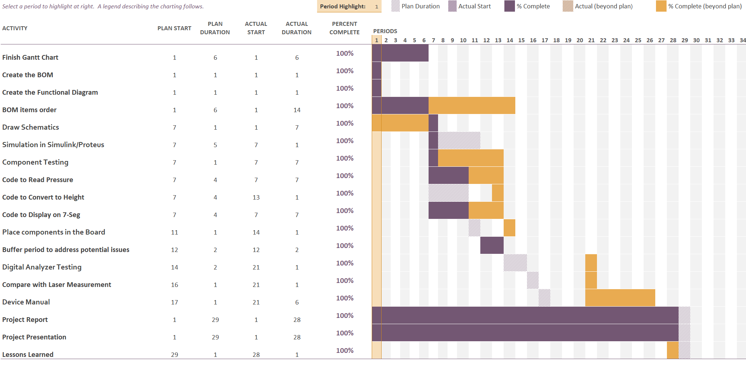
Gantt chart

Slide 6
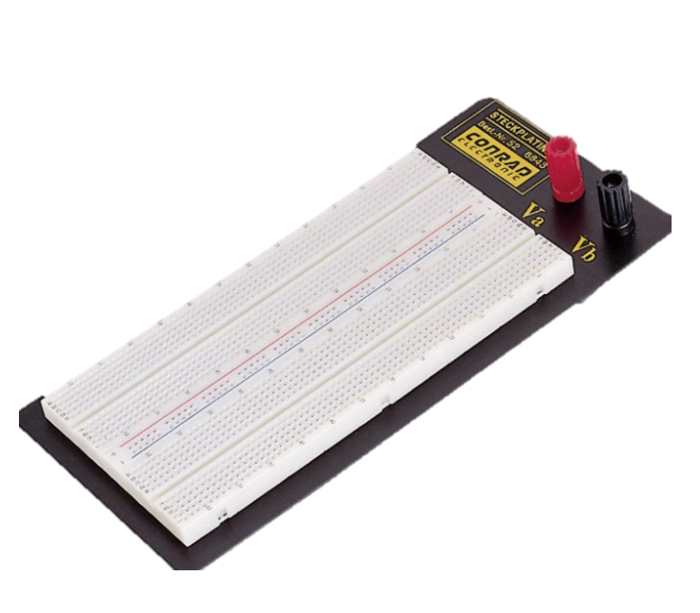
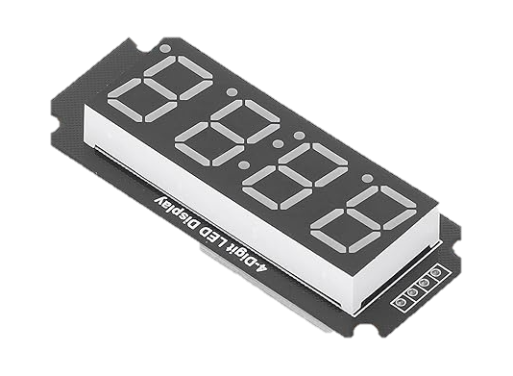
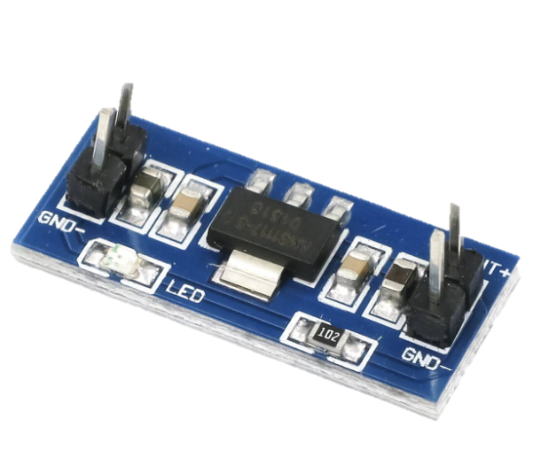
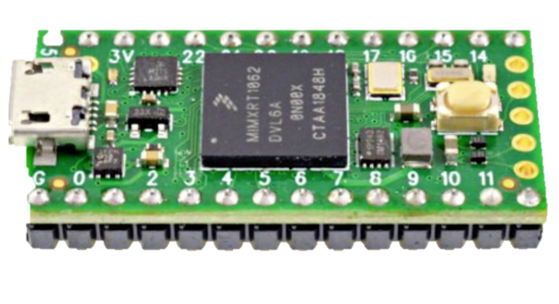
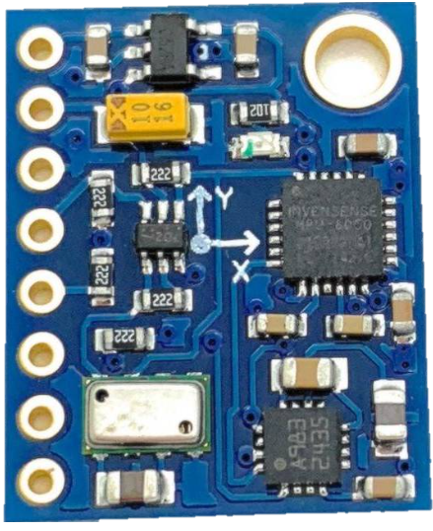
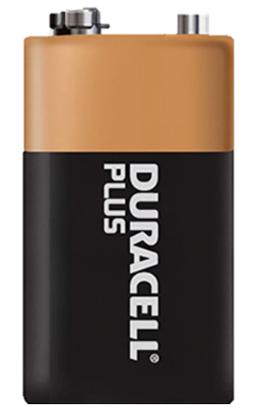
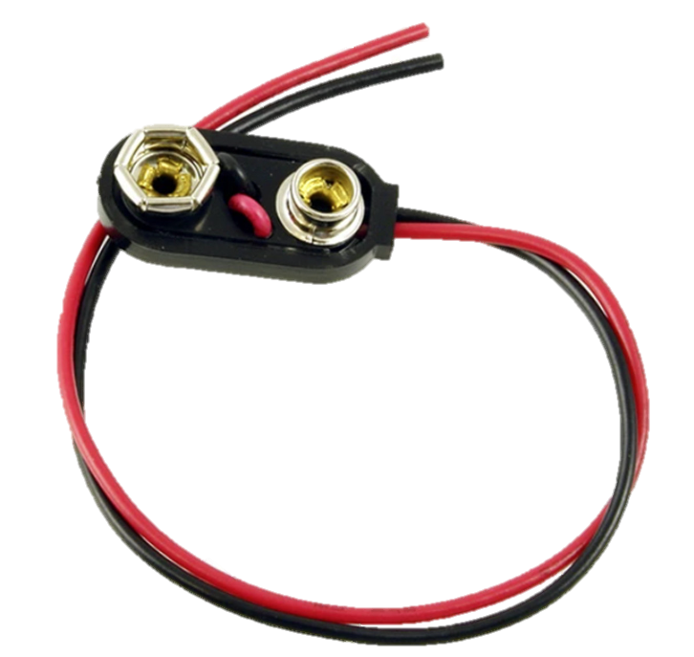
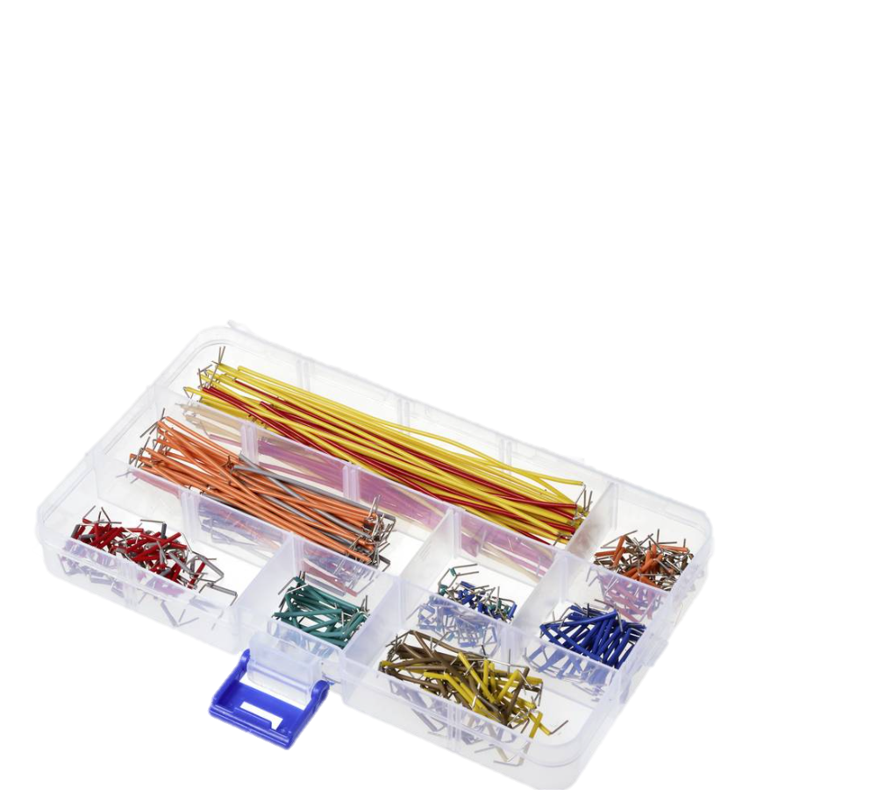
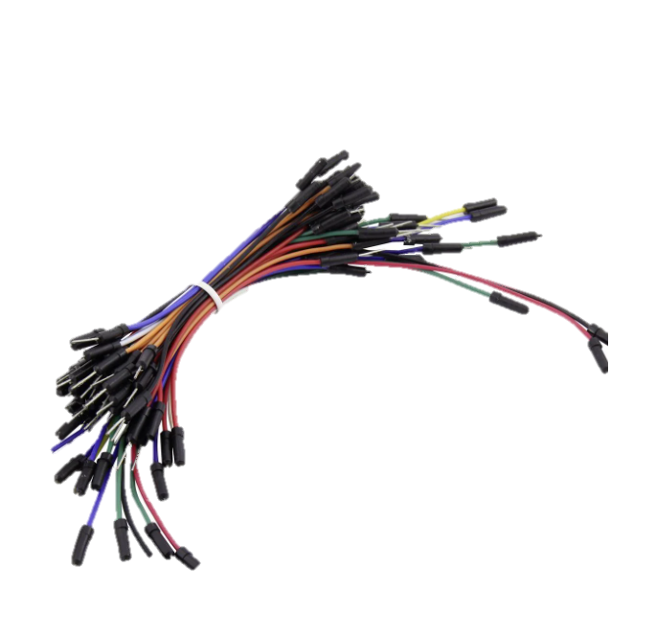
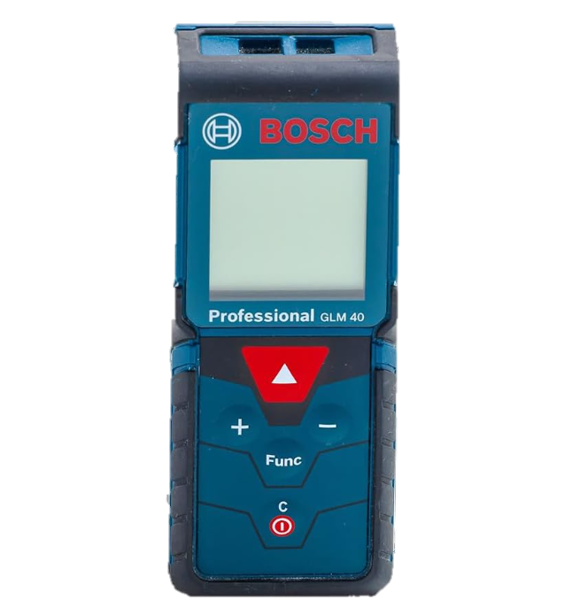
Bill of materials
EIC-104-3 circuit board
4-digit 7 segment LED TM1637
AMS1117-5 5V DC-DC Step-Down Converter
PJRC TEENSY 4.0 Development Board
GY-86 MS5611 Barometer
Additional materials:
6LF22 9V Battery
Battery clips
Plug in jumpers
Laser distance meter GLM 40

Slide 7
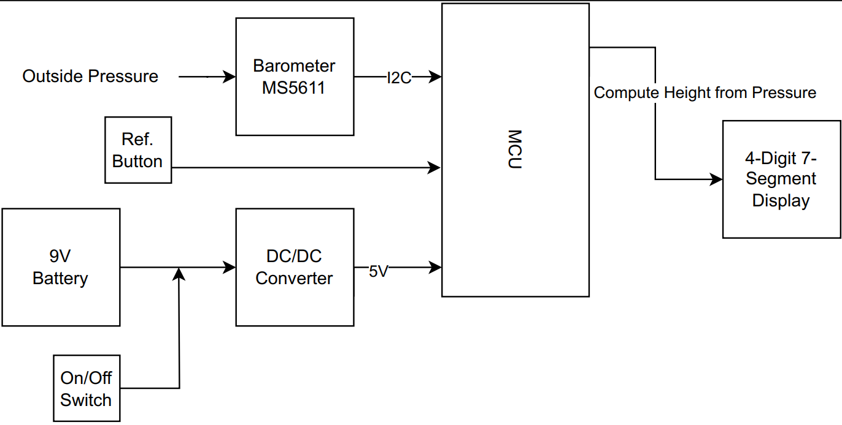
Block diagram of the altimeter

Slide 8
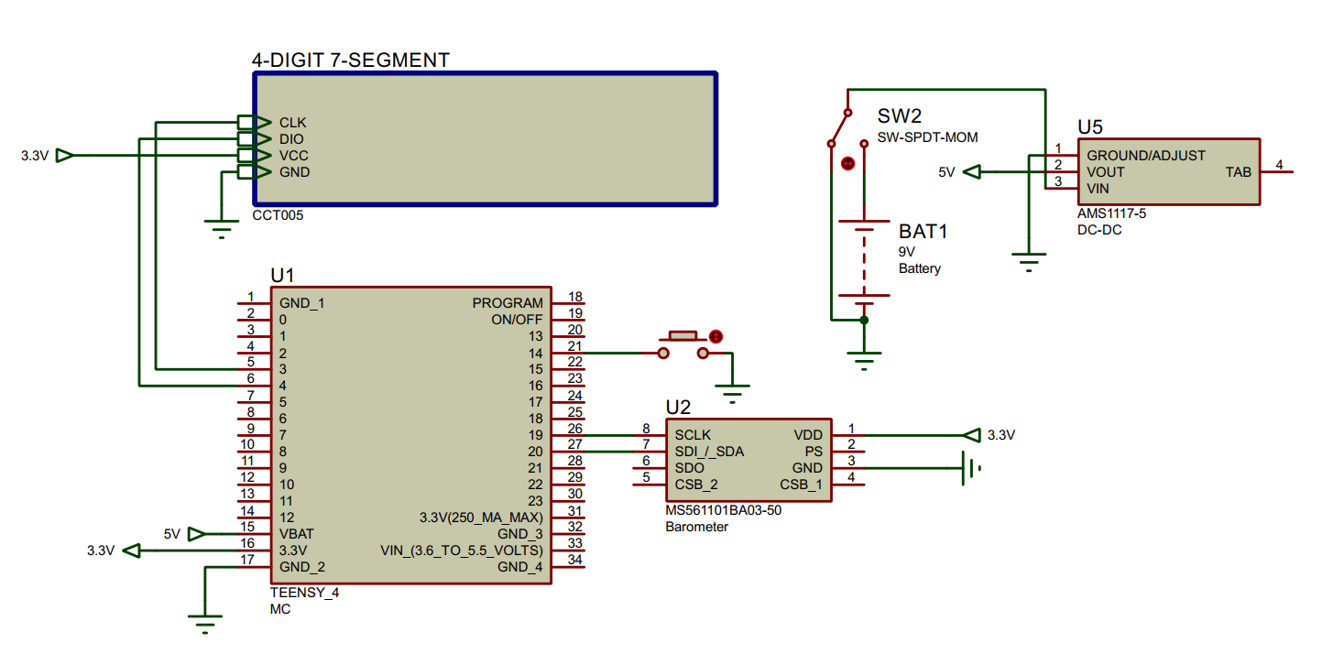
Schematics

Slide 9
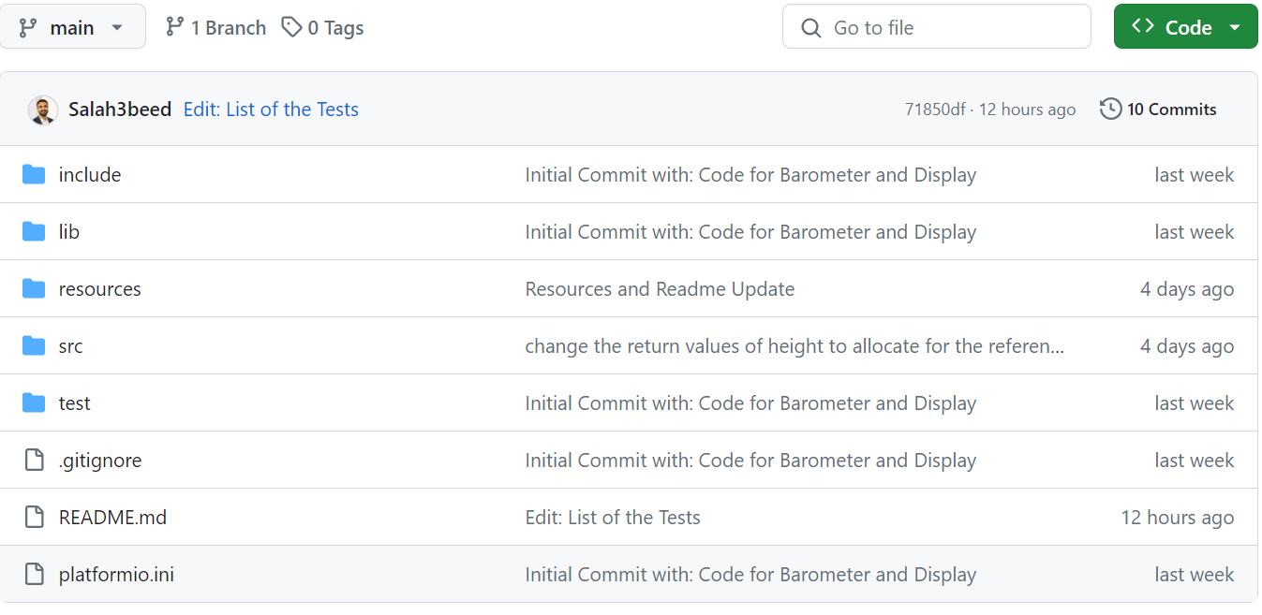
CODE (setup)
Repository Link

Slide 10
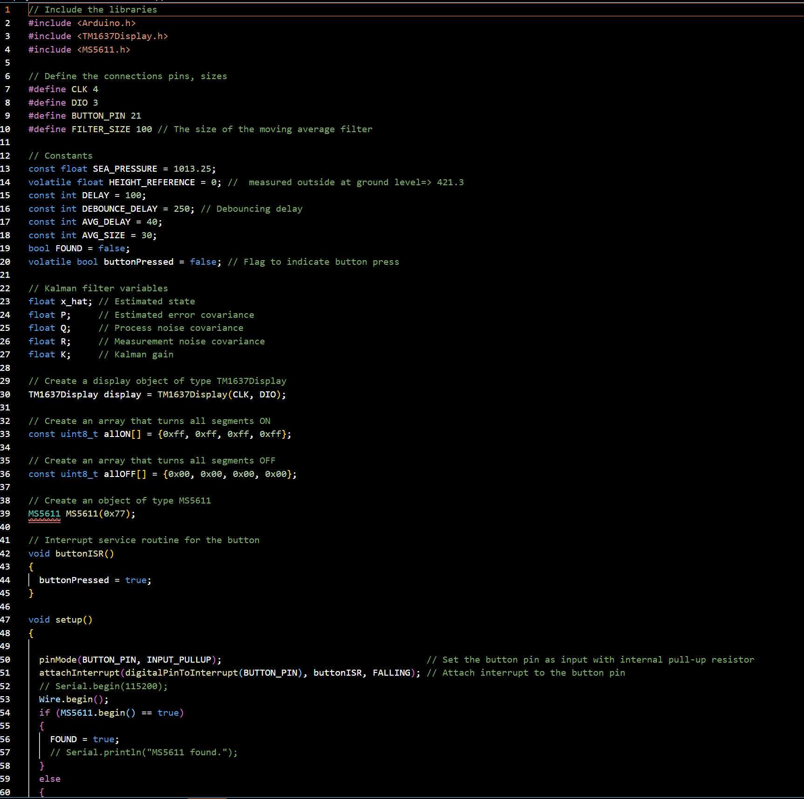
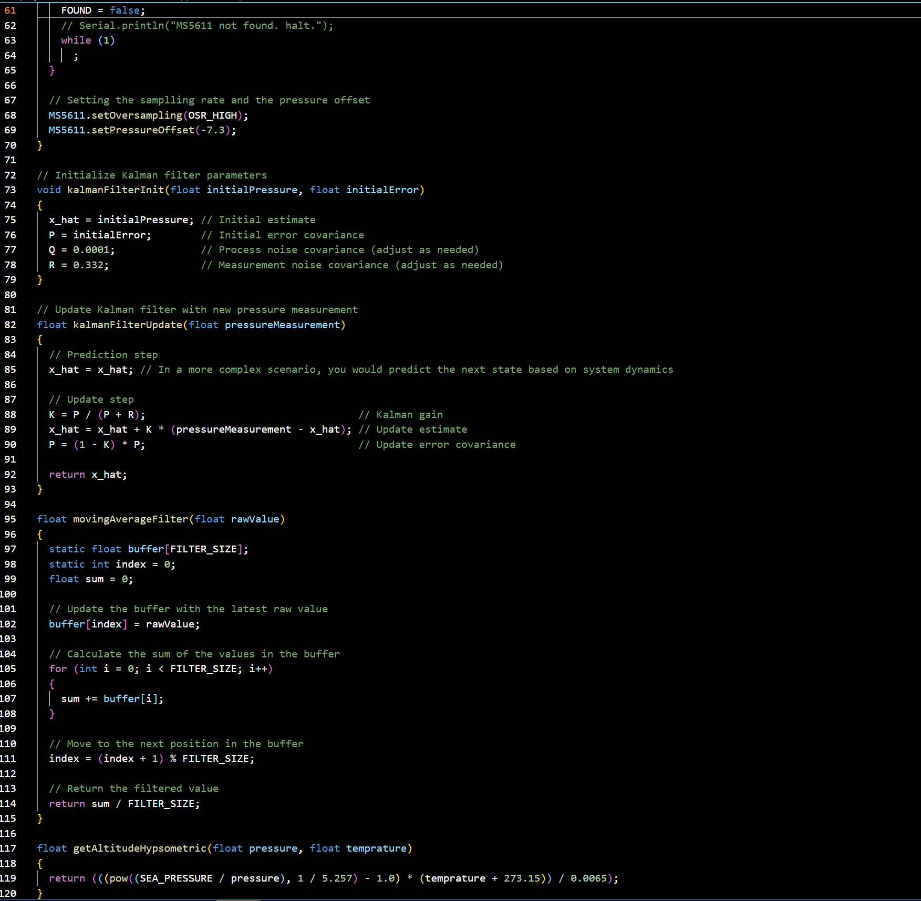
Actual code (1)

Slide 11
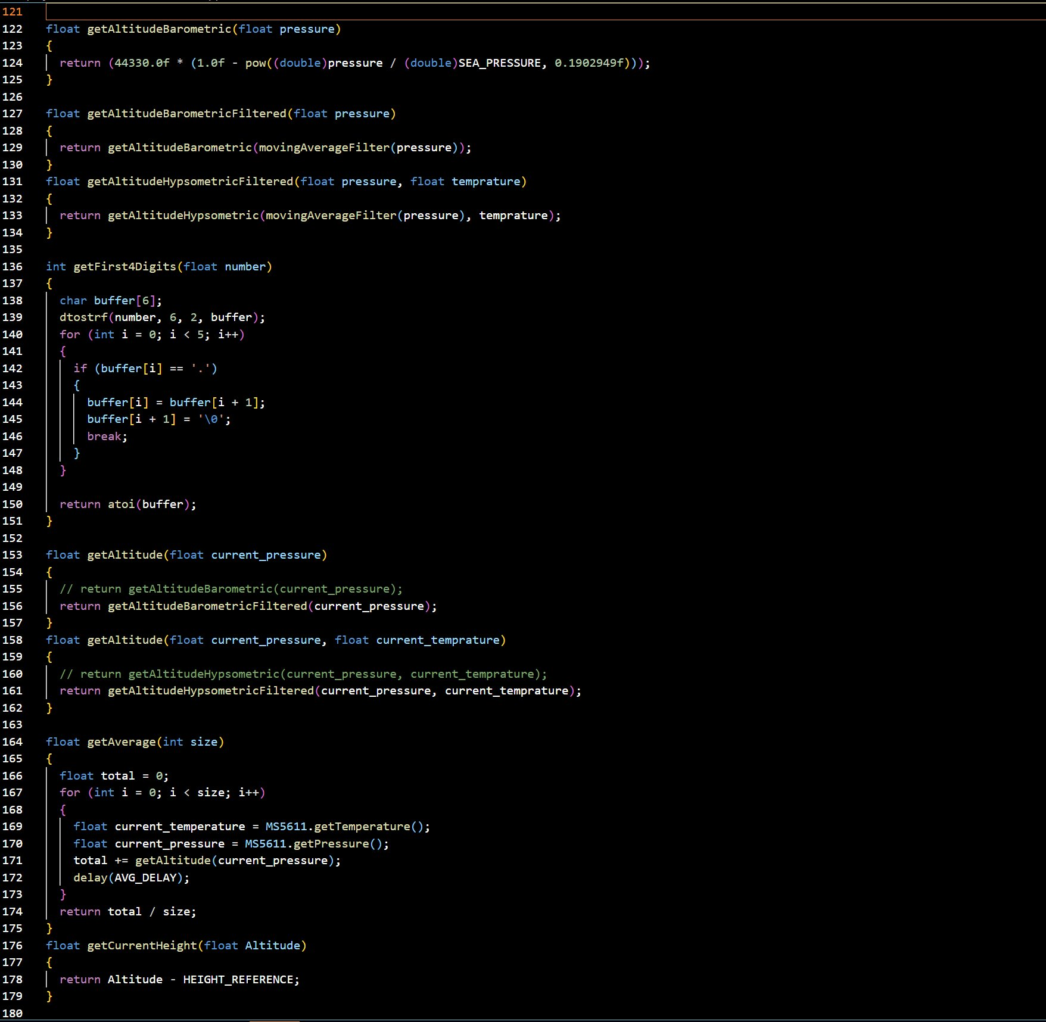
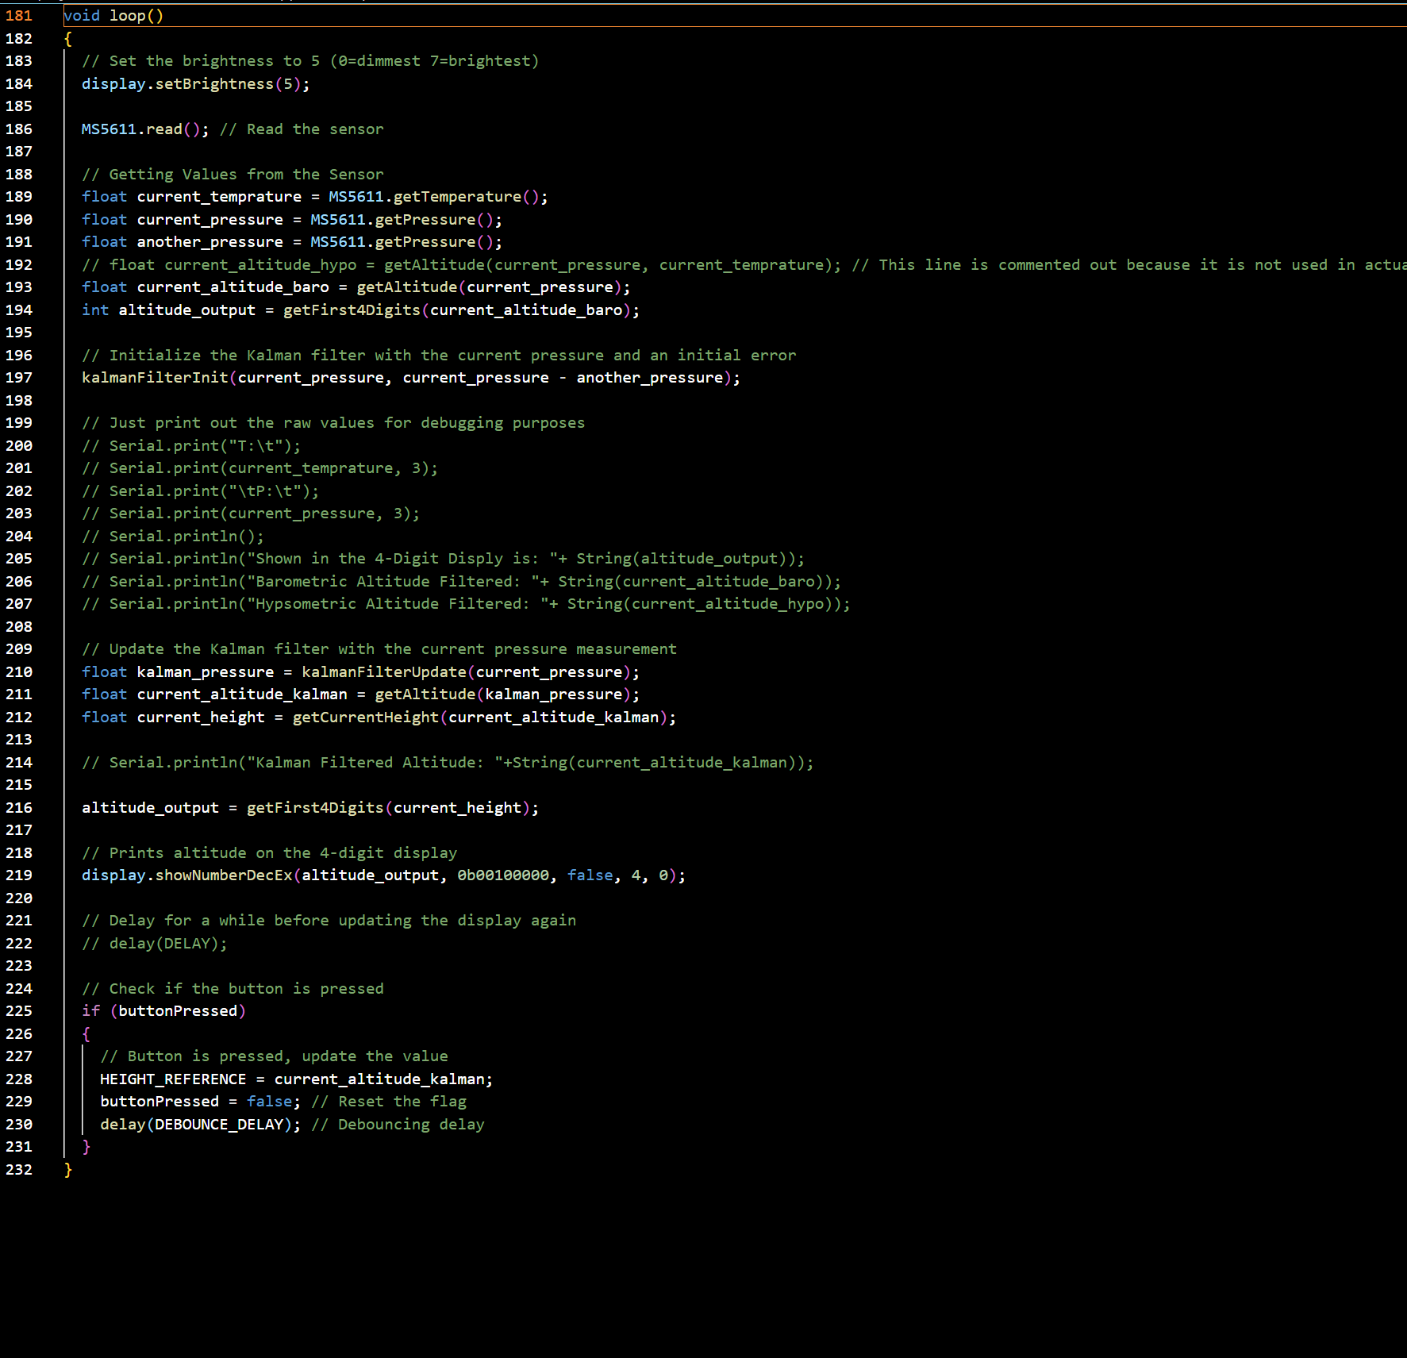
Actual code (2)

Slide 12
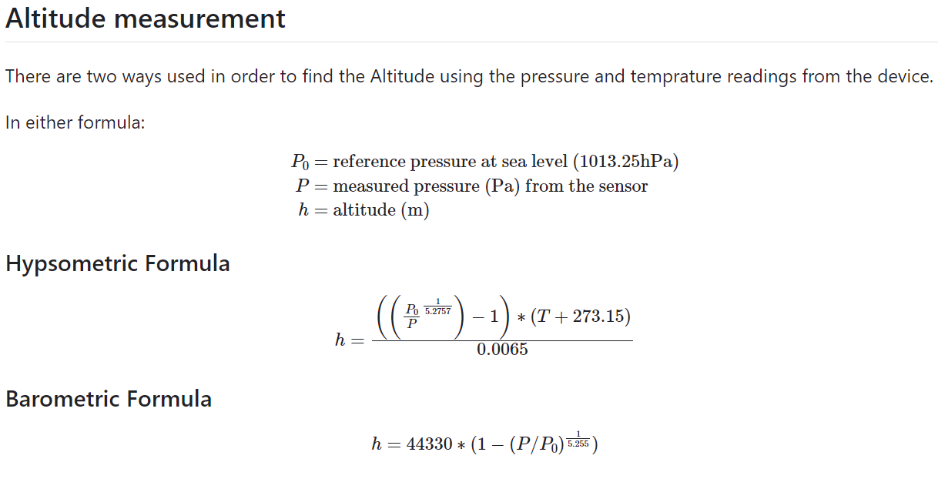
Altitude Calculation from sensor

Slide 13
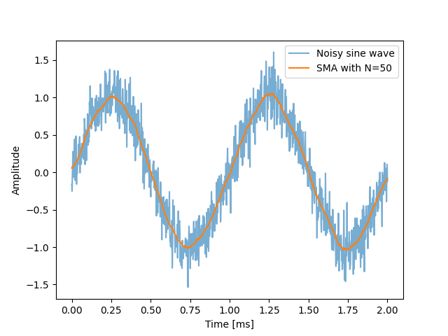
Measurement error and noise
Digital Filtering
For Pressure Values from the sensor:
Moving Average Filter
Source: Link

Slide 14
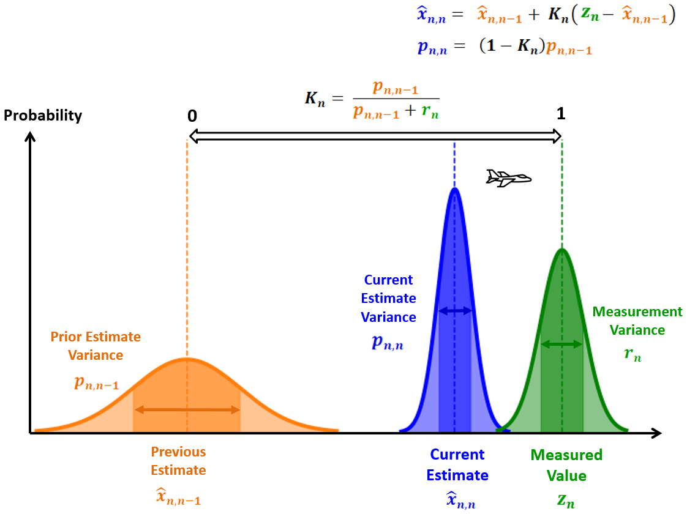
Measurement error and noise
Digital Filtering
For Altitude Values
Kalman Filter
Source: Link

Slide 15
Tests
Altitude, accuracy and sensitivity testing:
Tested altimeter accuracy in lab and outside
Varied altitudes systematically, compared to a reference and laser measurement
Evaluated sensitivity with subtle altitude changes
Response time and stabilization testing:
Introduced rapid altitude changes to track response time of display
Checked the time it took the altimeter to correctly measure the new altitude
Power Supply Variation Test:
Fluctuated input voltage using a 9V battery and various laptops with lower voltage to assess resilience of altimeter
Noted a difference in the processing capacity of the microcontroller at different voltage levels
Communication Interface Test:
Scrutinized Teensy 4.0 I2C communication with barometer
Validated constant altitude data transmission
Logic Analyzer test

Slide 16
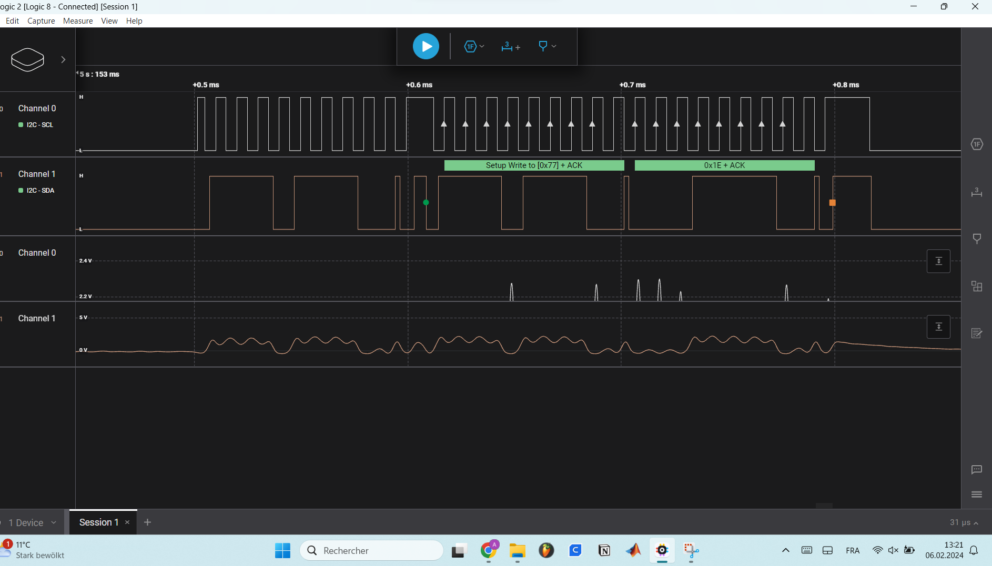
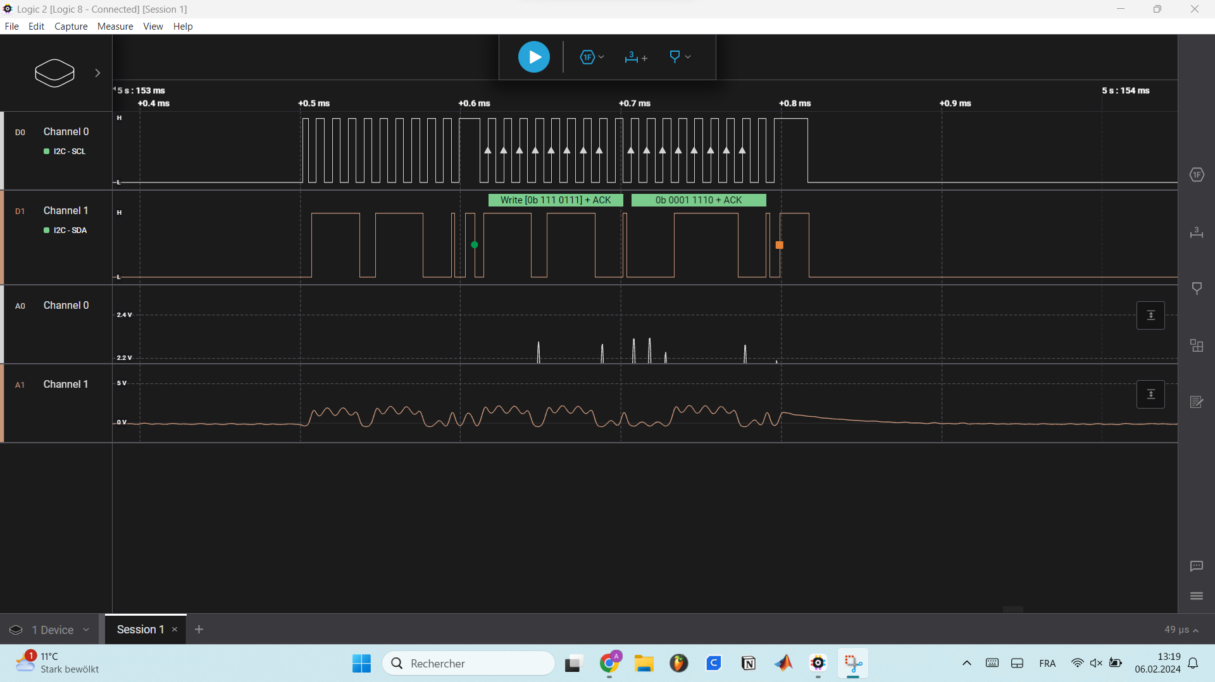
Tests
Communication Interface Test:

Slide 17
Manual
Most important contents of the manual:
1. Getting started (Power ON/OFF)
2. Display information (Altitude is shown in meters to reference ground)
3. Calibration (Calibration according to altitude and pressure in lab)
4. Operations (Use to get height difference to calibrated ground)
5. Maintenance (Keep dry and avoid impact of forces)
6. Contact (Questions should be addressed to TUM e-mail)

Slide 18
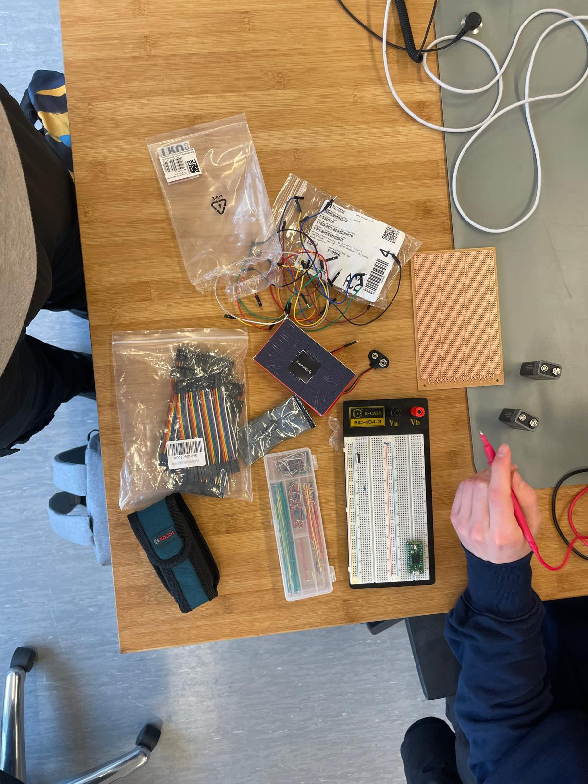
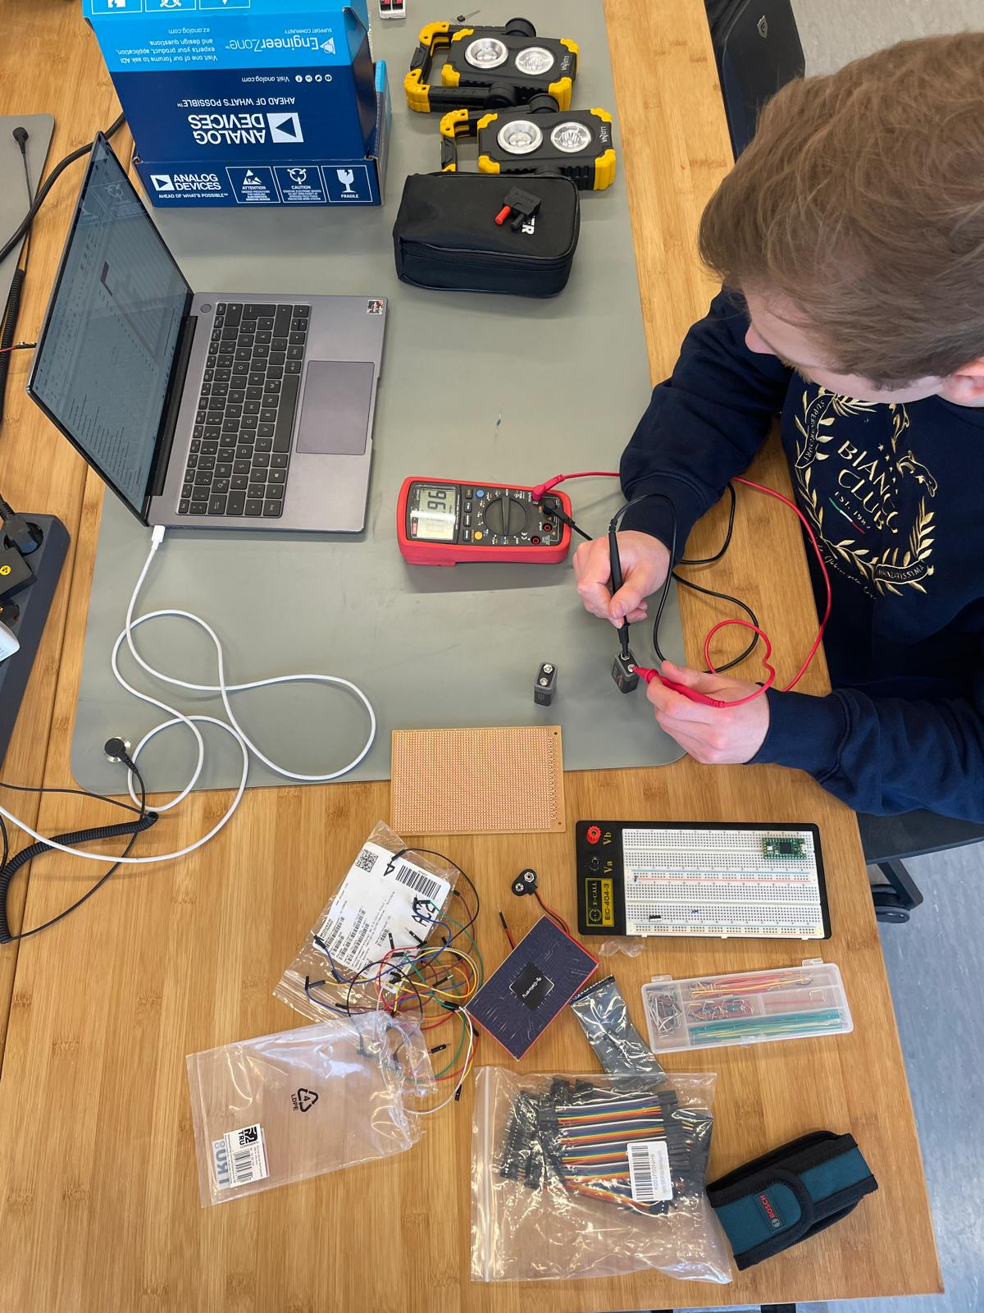
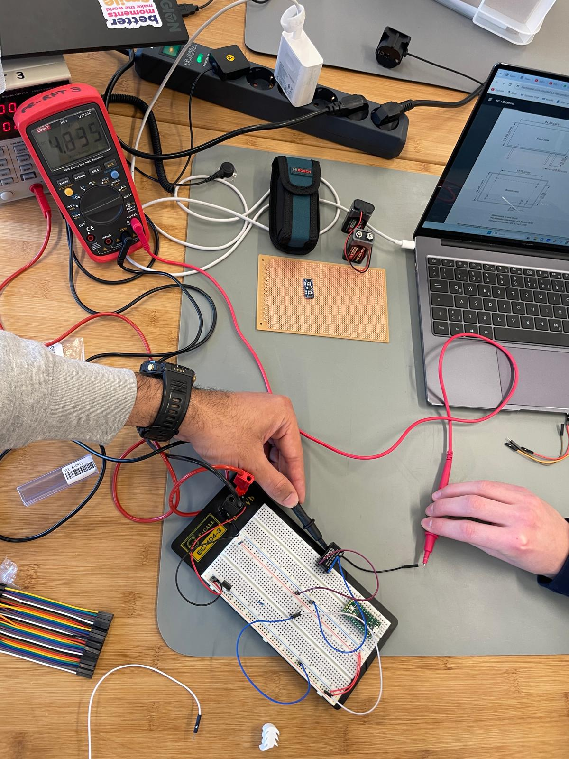
Pictures on the way
BOM completeness check
Battery voltage testing
DC-DC converter testing

Slide 19
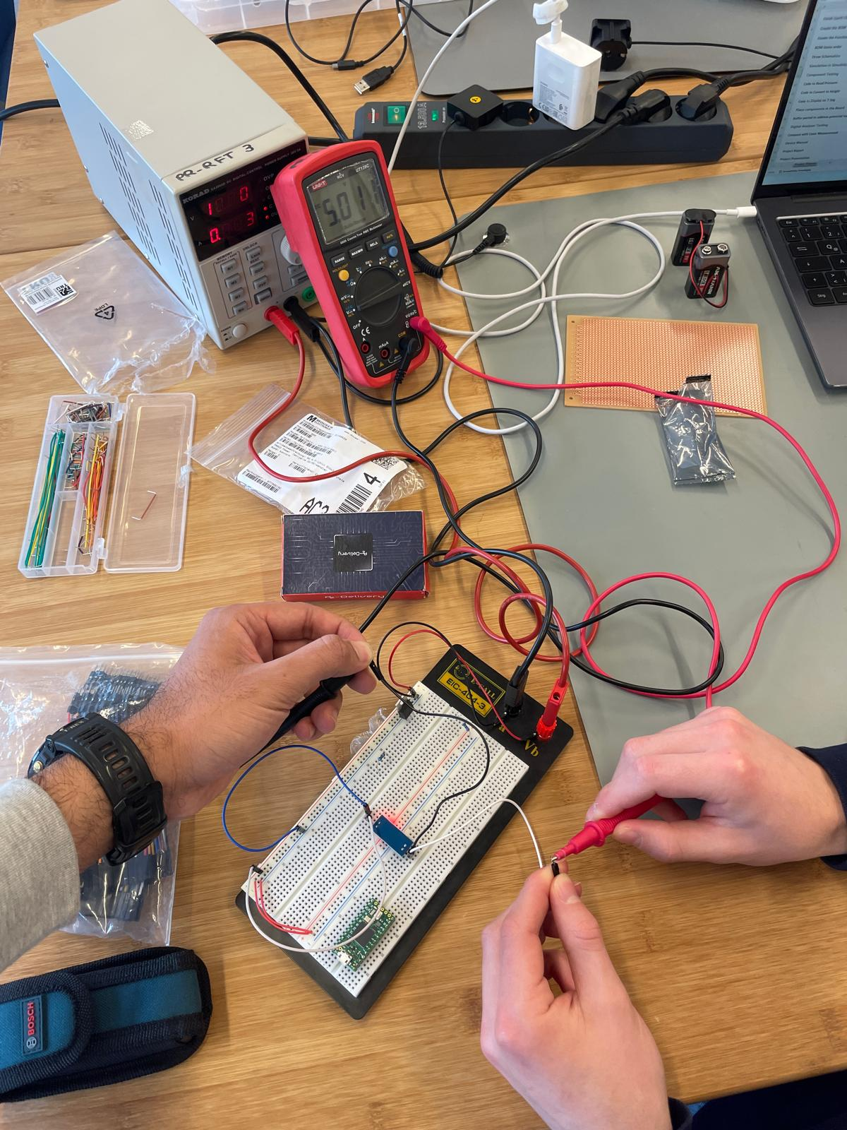
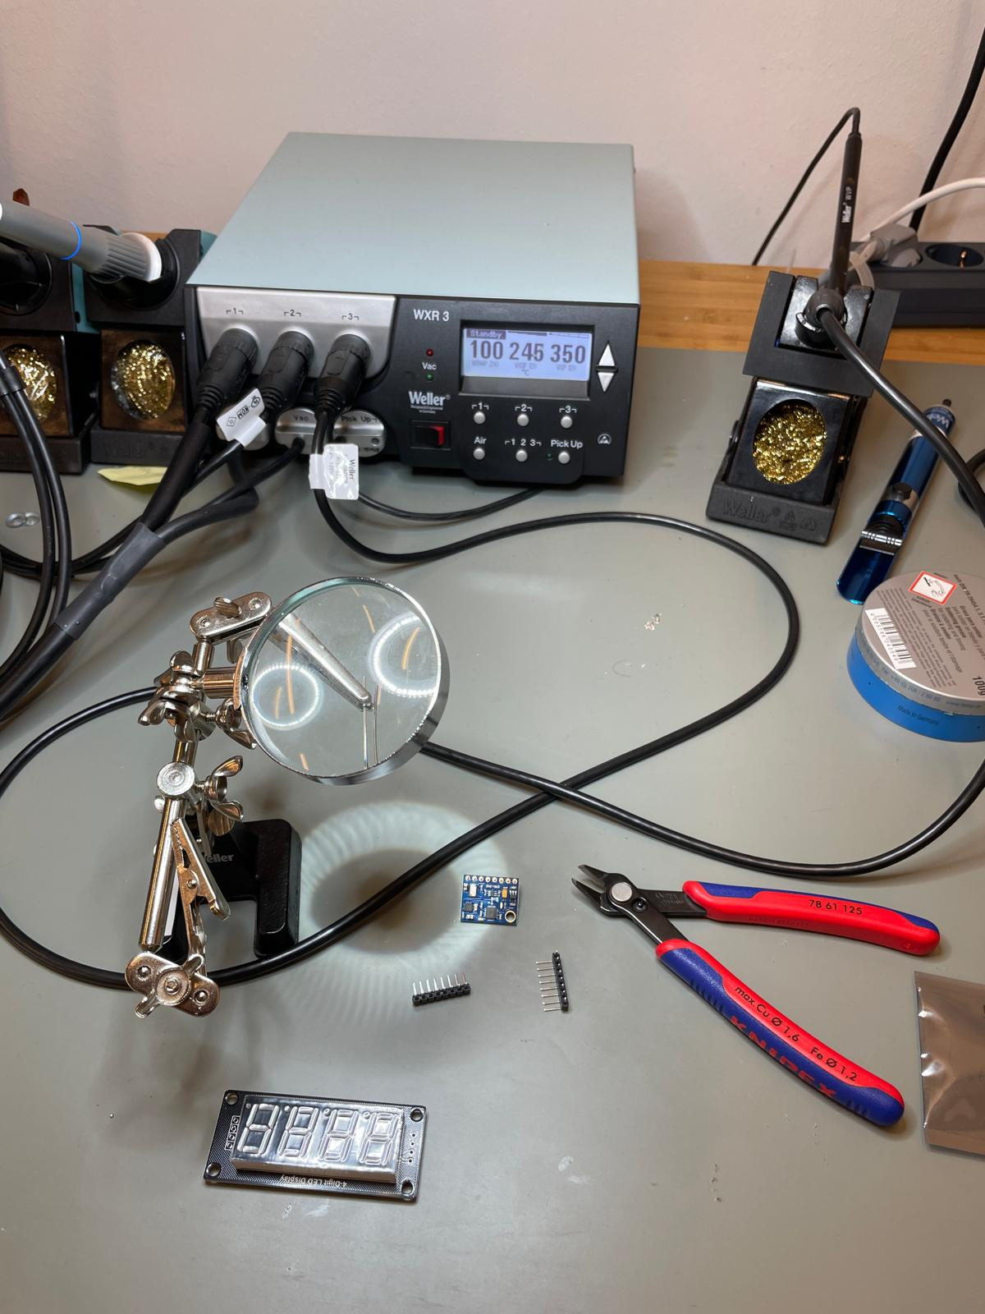
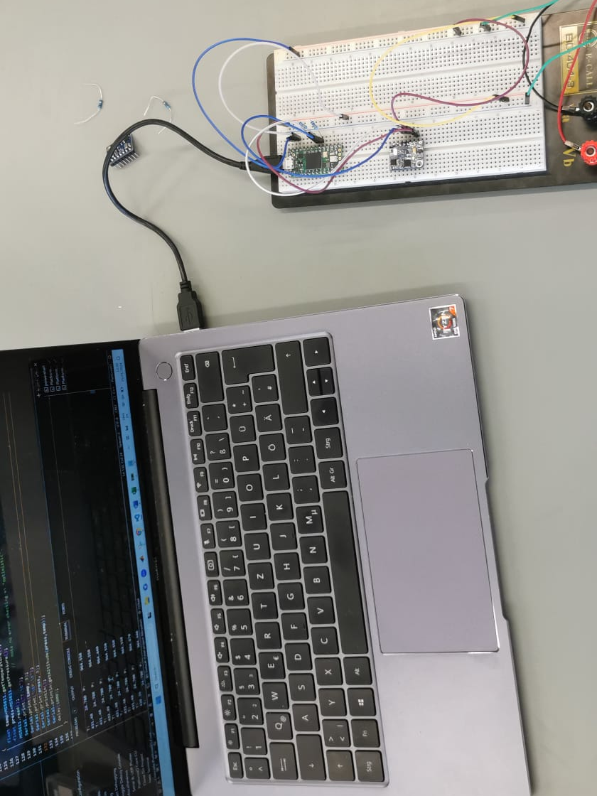
Pictures on the way
Barometer testing
Soldering of PCB pins
Code to read barometer

Slide 20
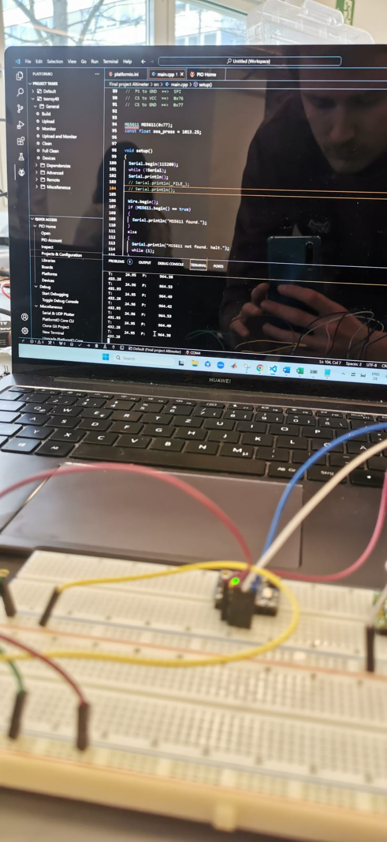
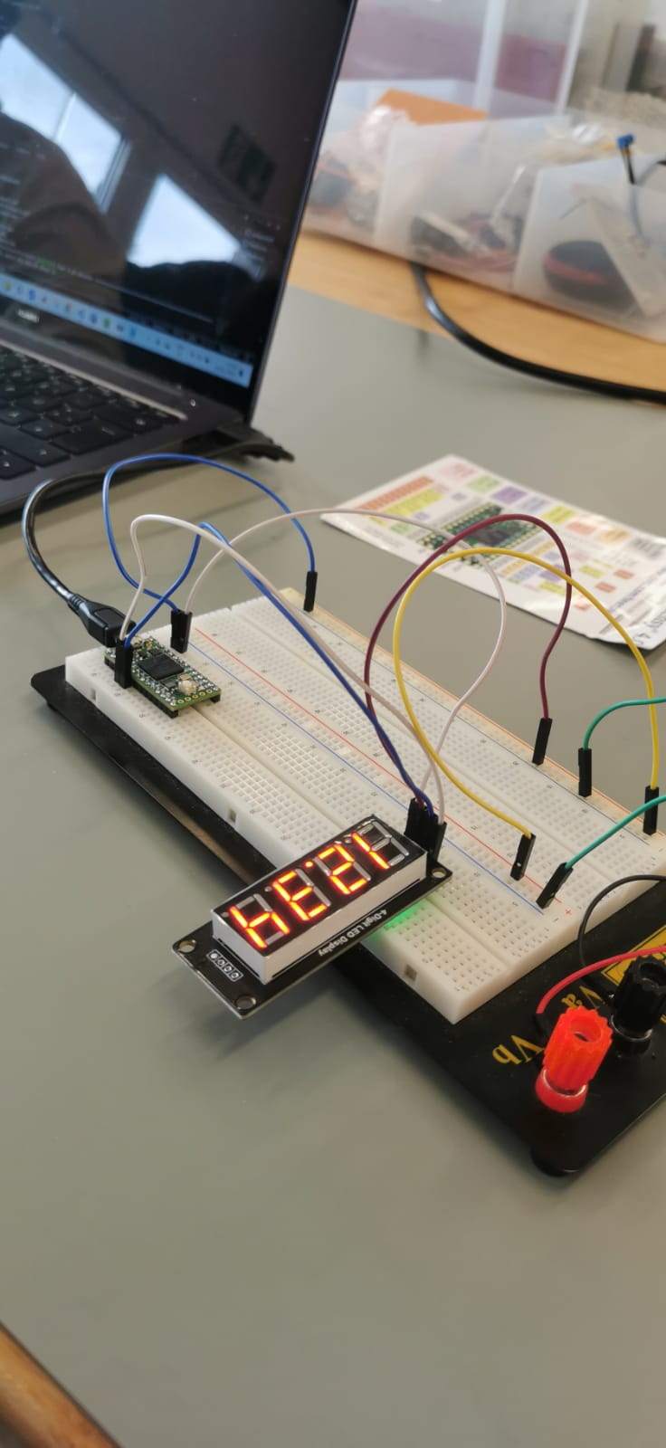
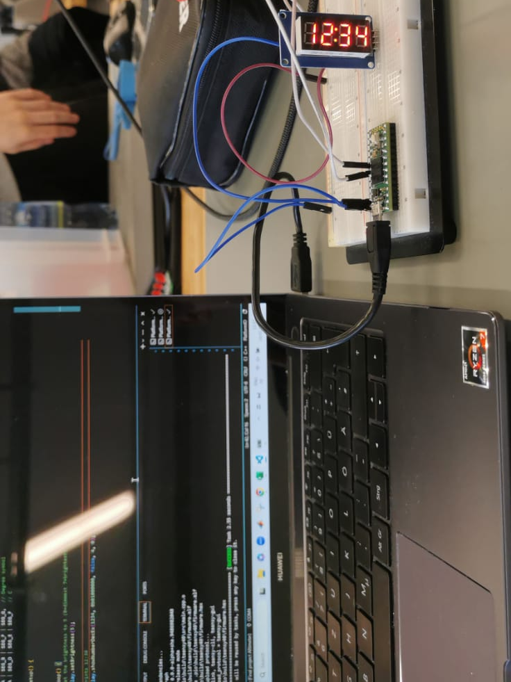
Pictures on the way
Code testing for LED display
Check of barometer input
LED display exchange

Slide 21
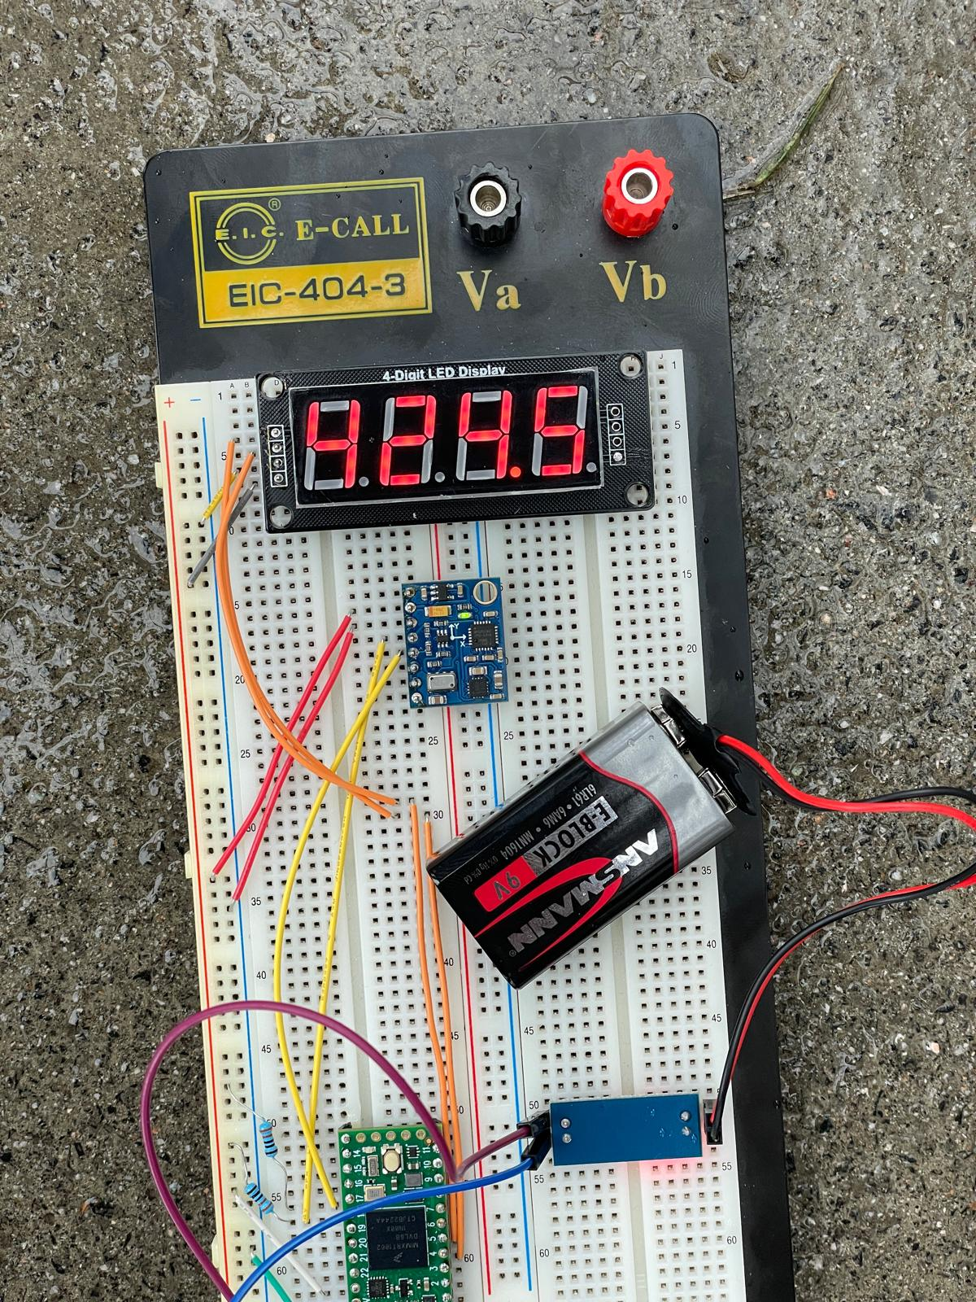
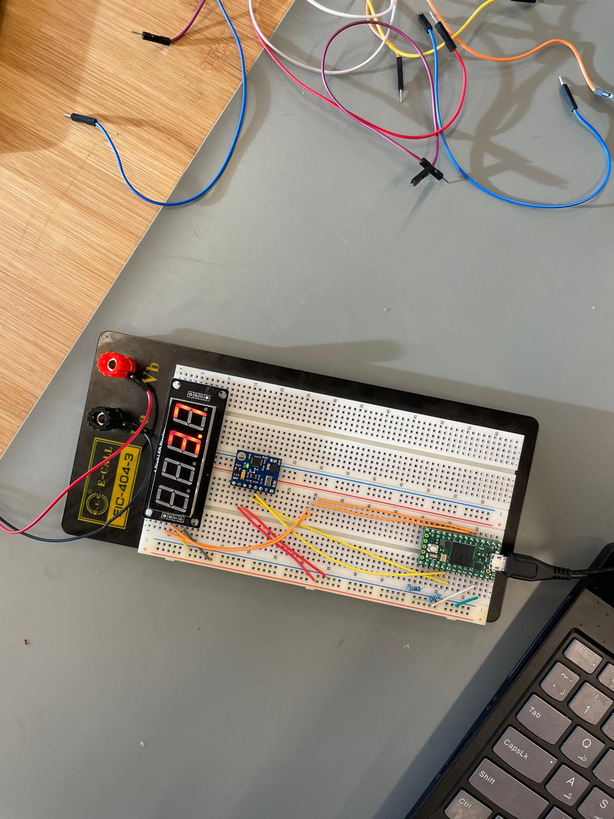
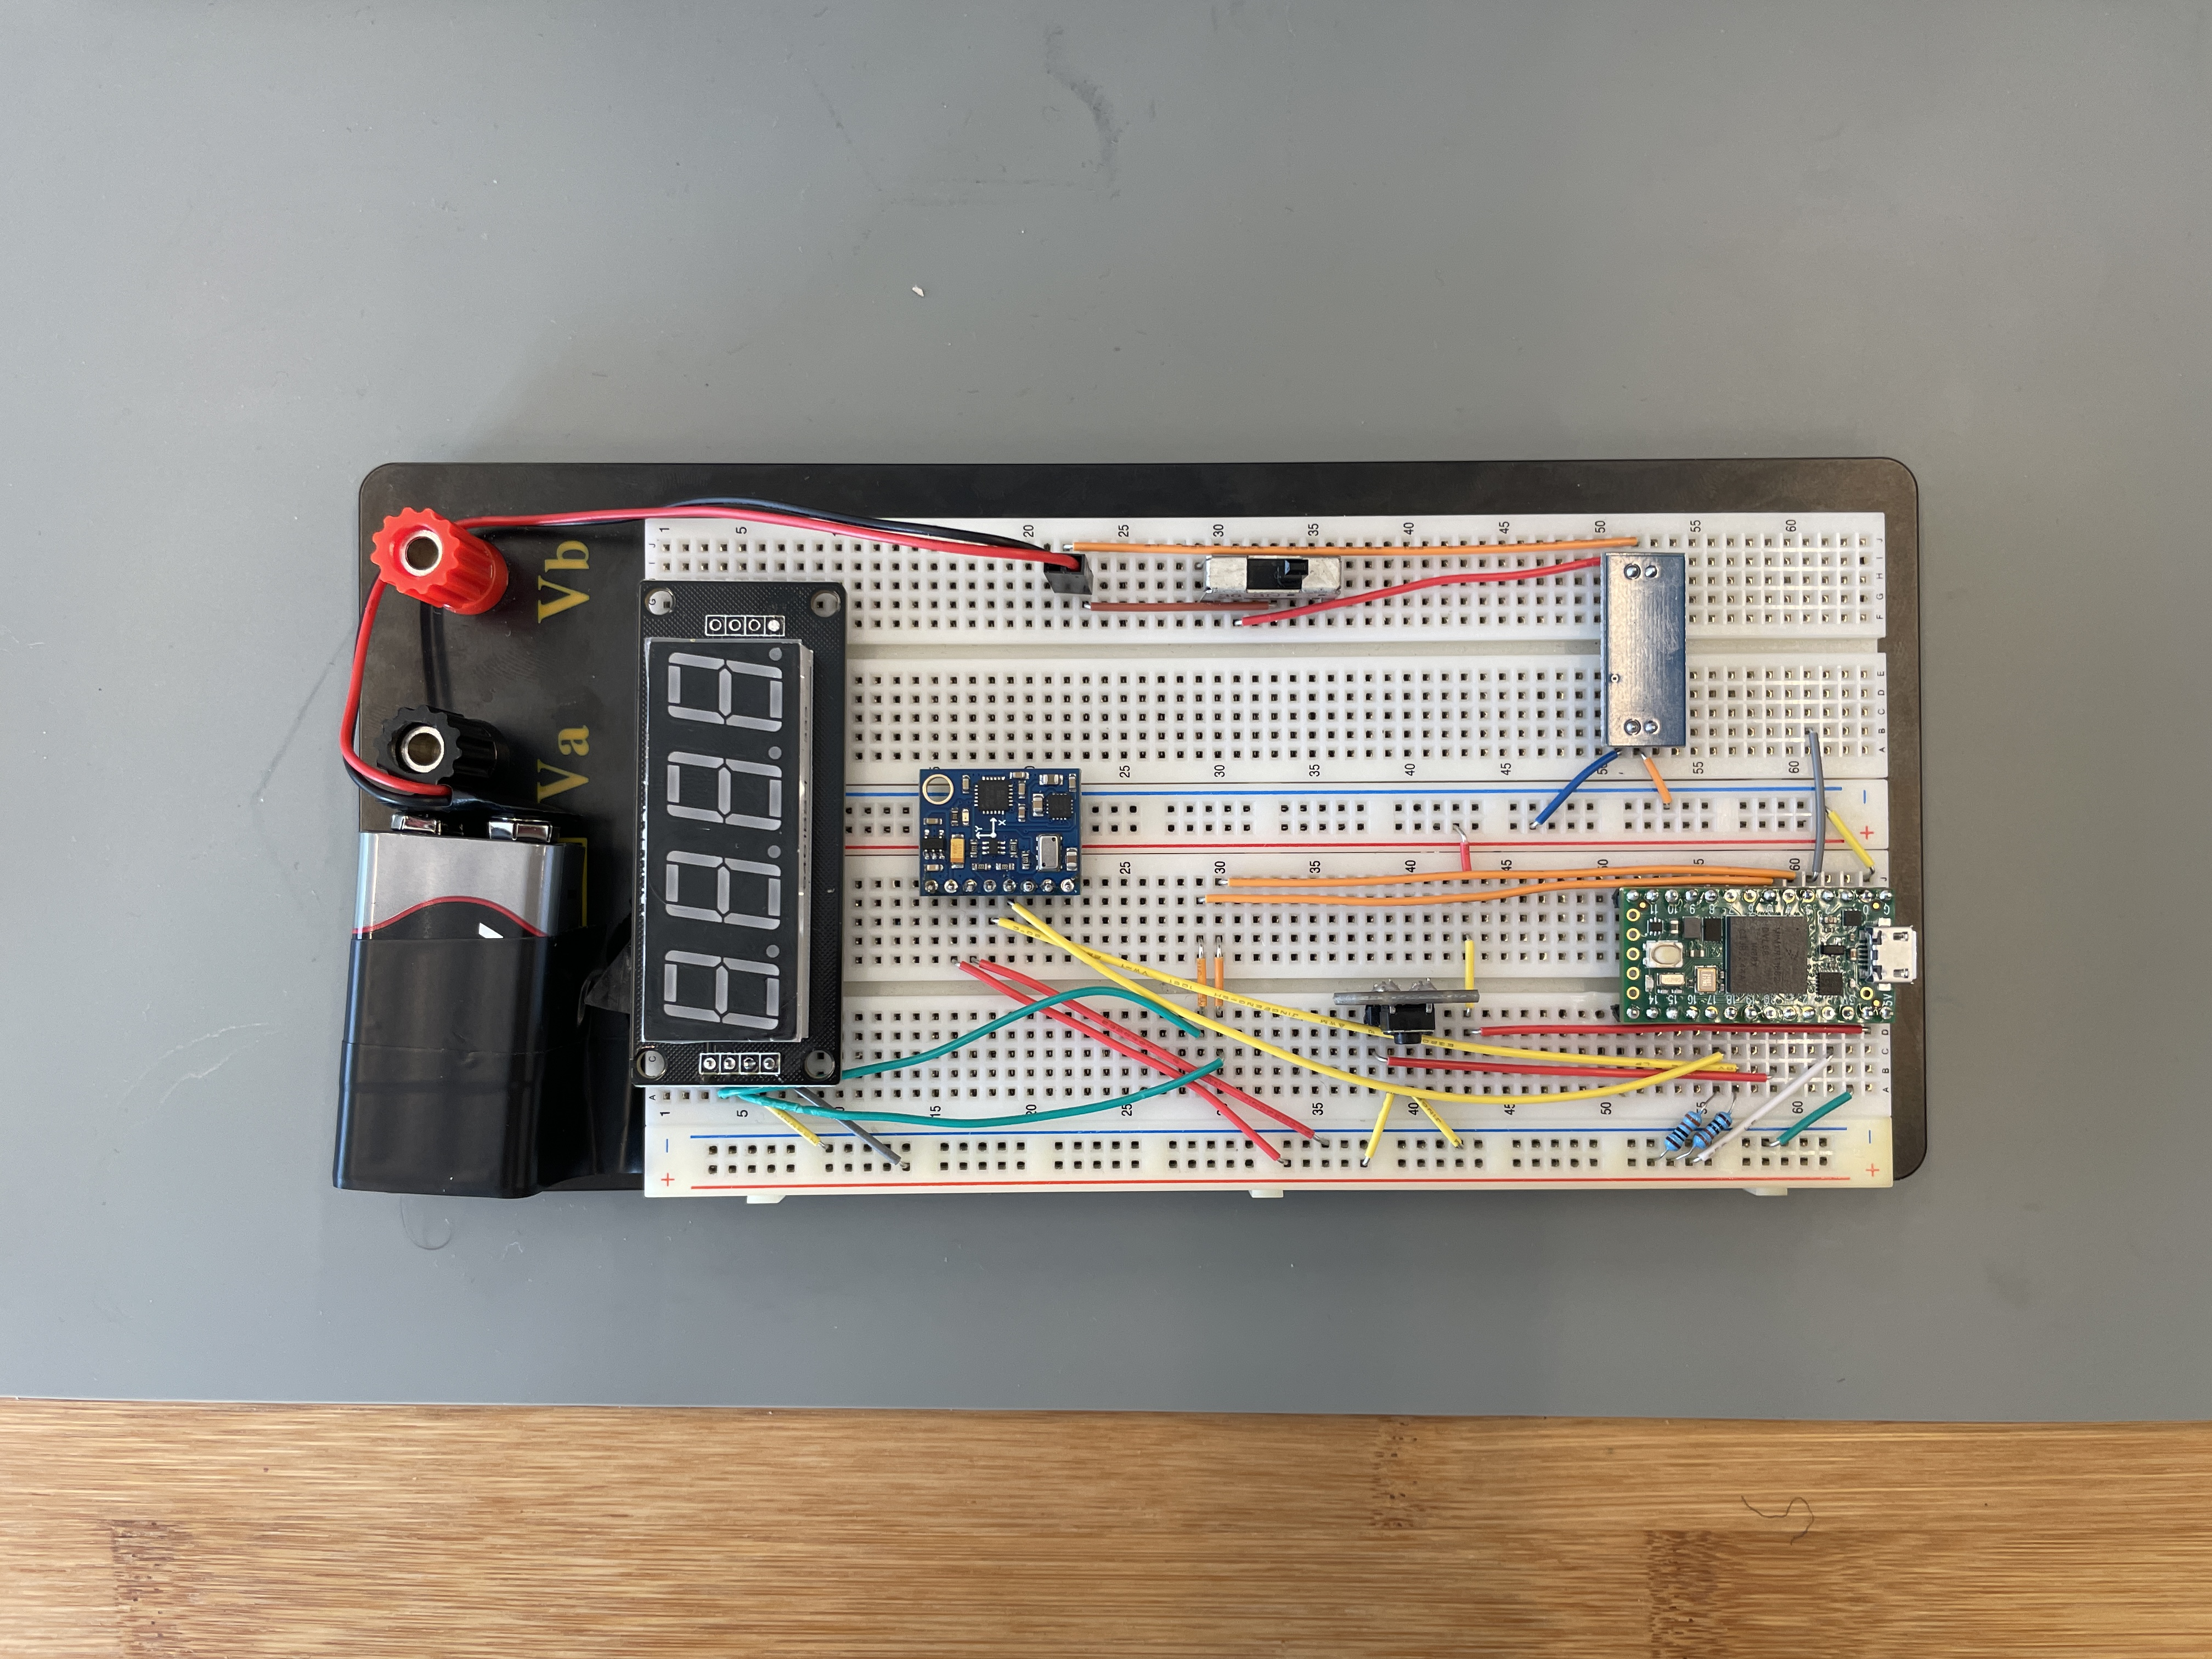
Pictures on the way
Outside ground calibration
Inside height calibration
Final altimeter

